Slide 1
FINAL CONFERENCE
LCA and LCC for a Business Case adopting BITMAPS Technology
“Pilot technology for aerobic Biodegradation of spent TMAH Photoresist solution in Semiconductor industries – LIFE BITMAPS”
V. Innocenzi, Researcher
Department of Industrial and Information Engineering and Economics of the University of L’Aquila, Italy
This Project receives funding form the European Union Life Programme Under Grant Agreement N. LIFE 15 ENV/IT 000332

Slide 2
OUTLINE
Objectives
Functional unit and system boundary
Life Cycle assessment study
- LCA method
- LCA results
Life Cycle costing study
- LCC method
- LCC results
Economic feasibility
Conclusions

Slide 3
Objectives
1. The life cycle assessment (LCA) and life cycle costing (LCC) methods applied in Life Bitmaps processes (TMAH, BOE and SEZ) are presented. The initial data used for the study are the results of the process analysis performed for the Business Case.
2. A comparison in terms of environmental and economic impact will be presented between Life Bitmaps Processes and the current method for wastewater disposal
3. Economic feasibility for the Business Case has been presented

Slide 4
Functional unit and system boundary
The LCA technique used in this study is based on the ISO 14040 and ISO 14044 guidelines and requirements, and consists of four steps:
goal and scope definition
inventory analysis
assessment (classification, characterization, normalization and weighting)
interpretation
The functional unit is the base for the treatment comparison in the life-cycle inventory.
Functional unit: annual production of wastewater
6300 tons TMAH and photorsesist (continuous operation)
435 tons BOE (batch operation)
145 tons SEZ (batch operation)
All materials, emissions, energy consumption and cost are referred to this functional unit.
The study is carried out by the thinkstep GaBi software-System and Database for Life Cycle Engineering used for the production processes of energy and raw materials and for the quantification of the environmental impact of the treatments

Slide 5
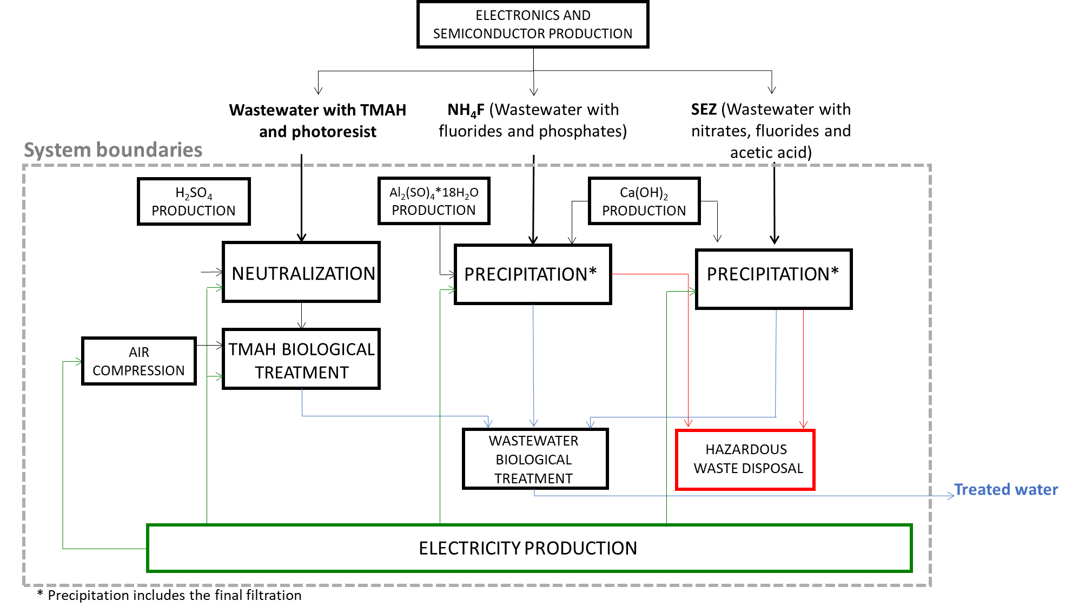
Functional unit and system boundary
an innovation introduced by the project
System boundaries for the processes proposed in the Life Bitmaps for the wastewater treatment

Slide 6
Functional unit and system boundary
Details of TMAH degradation process

Slide 7
LCA method: collection of input and output
Input | Output
Line 1: Wastewater with TMAH and photoresist (continuous operation; plant capacity 800 kg/h; 7920 operating hours/year)
Wastewater, 800 kg/h Sulfuric acid (98%), 3 kg/h Water, 7 kg/h Electricity, 80 kW | Treated wastewater, 810 kg/h
Line 2: Wastewater with NH4F (BOE) (batch operation; 150 batch/year; 2h per batch)
Wastewater, 2900 kg/batch Lime, 684 kg/batch Water 2737 kg/h Al₂(SO)₄*18H₂O, 116 kg/batch Electricity, 50 kWh/batch | Treated wastewater, 4968 kg/batch Solid waste (about 50% dry), 1470 kg/batch
Line 3: Wastewater with nitrates, fluorides and acetic acid (SEZ) (batch operation; 50 batch/year; 2h per batch)
Wastewater, 2900 kg/batch Lime, 679 kg/batch Water, 2714 kg/batch Al₂(SO)₄*18H₂O, 116 kg/batch Electricity, 50 kWh/batch | Treated wastewater, 4874 kg/batch Solid waste (about 50% dry), 1535 kg/batch
Business Case
Energy and mass balances involved within the LIFE BITMAPS innovative processes

Slide 8
LCA method: definition of the impact categories
The impact categories and the related characterization methods are selected in agreement with the Product Environmental Footprint (PEF) guidelines and the ILCD recommendation.
The following categories are considered:

Slide 9
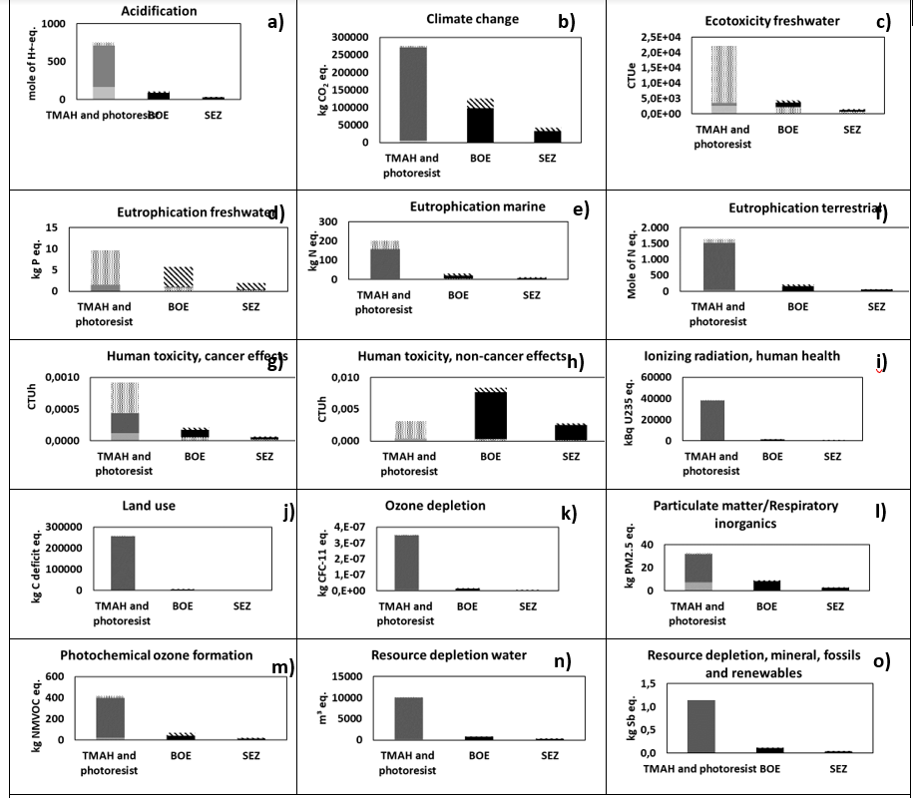
LCA results
Life Cycle Impact Assessment: Classification and characterization
Quantification of the environmental impact of the innovative LIFE BITMAP technologies.
(Functional unit: annual production of wastewater, 6300 t TMAH, 435 t BOE, 145 t SEZ)
For TMAH wastewater treatment:
According to the Figure: Climate change, freshwater ecotoxicity, land use, ionizing radiation, human health and resource depletion water are the main effects.
All these categories are affected by the electricity consumption used for the aeration of the biological process.

Slide 10
LCA results
Life Cycle Impact Assessment: Classification and characterization
Quantification of the environmental impact of the innovative LIFE BITMAP technologies.
(Functional unit: annual production of wastewater, 6300 t TMAH, 435 t BOE, 145 t SEZ)
For BOE and SEZ wastewater treatment:
According to the Figure: Climate change, freshwater ecotoxicity are the main effects.
Climate change is affected by the waste disposal and lime consumption.
Freshwater ecotoxicity is mainly affected by the biological treatment of the treated BOE and SEZ, followed by aluminum sulfate production and lime consumption

Slide 11
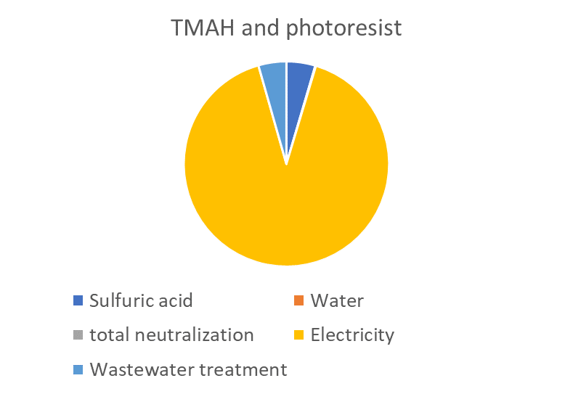
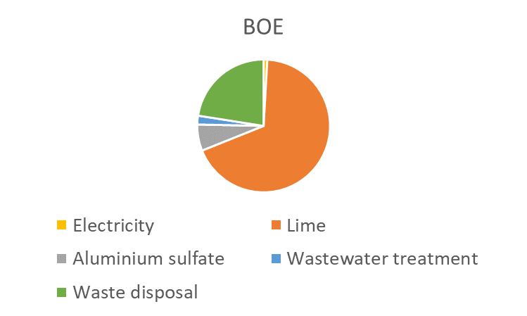
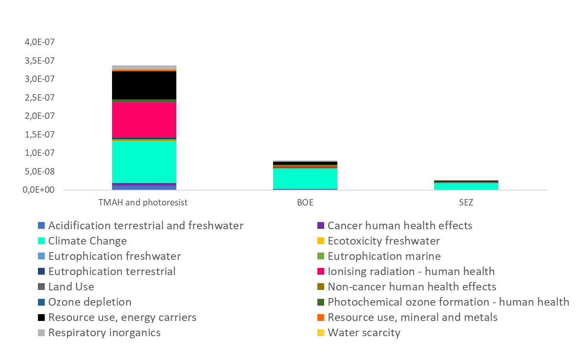
LCA results
Normalization and weighting
In order to have an overview of the environmental load of the three lines the following graph is reported. It is possible to see that the climate change as the most affected categories.
Output of the normalization and weighting step of LCIA. The pie charts show the detail of process contributions
As displayed by the pie charts, the lime use is the main critical issue for both the BOE and SEZ treatments (70% and 40%, respectively), in agreement with the results explained within the classification and characterization section.

Slide 12
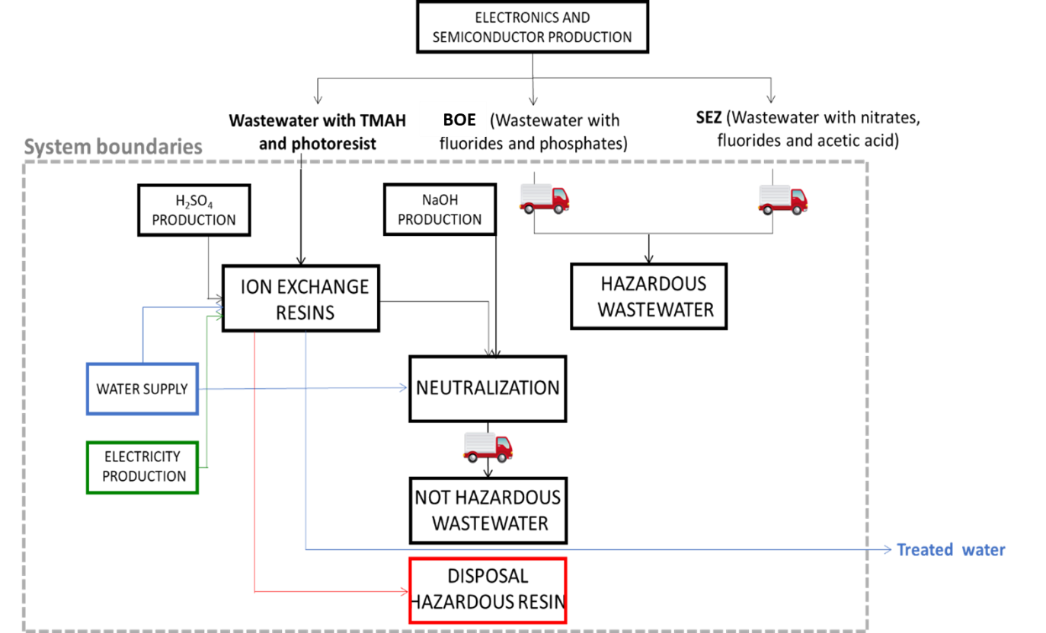
LCA results
Life Bitmaps processes Current wastewater treatment
Vs
System boundaries for the current wastewater treatment

Slide 13
LCA results
Life Bitmaps processes Current wastewater treatment
Vs
Input | Output
Line 1: Wastewater with TMAH and photoresist
Wastewater, 800 kg/h Sulfuric acid (98%), 5 kg/h Sodium hydroxide, 2 kg/h Deionized water, 300 kg/h Electricity, 0.6 kWh Resin, 35 kg/h | Treated wastewater, 800 kg/h Not haz. wastewater, 307 kg/h Hazardous resin, 35 kg/year
Line 2: Wastewater with NH4F (treated by external companies)
 | Hazardous wastewater, 60 kg/h
Line 3: Wastewater with nitrates, fluorides and acetic acid (SEZ), (treated by external companies)
 | Hazardous wastewater, 16.5 kg/h
System boundaries for the current wastewater treatment

Slide 14
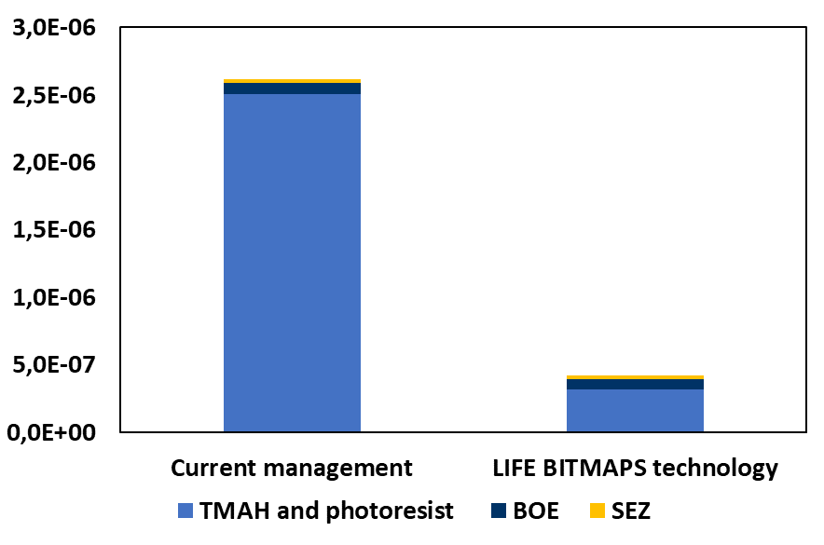
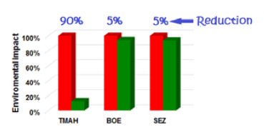
LCA results
Life Bitmaps processes Current wastewater treatment
Vs
The whole process improvement, with an impact decrease higher than 50%, is evident, mainly thanks to the TMAH process optimization. Comparable results are related to the other two lines, with the advantage of a process carried out within the same facility
Comparison between the current and the innovative options considering the total normalized and weighted results

Slide 15
LCC methods
LCC
LCC = CC + VC + WMC + TC – S (€/functional unit)
CC capital costs (plant infrastructure, equipment cost and supporting parts)
VC variable operating costs (is the cost of materials and energy whose usage varies depending on the level of wastewater treatment. In VC, the labour cost is also considered).
WMC waste management costs (include landfill and incineration of waste. In the specific case it has been considered the cost of disposal of solid in landfill)
TC transport costs (in the specific case TC is included on WMC)
S revenue (in this specific case, S is the gain on non-disposal of wastewater in the specific plant off-site)

Slide 16
LCC results
TMAH treatment
The Direct Fixed Capital (DFC) = 900,000.00 € (equipment cost, piping, engineering, …) (real quotation).
Straight line depreciation over 10 years is considered with an index of 7.7.
Item | €/year | €/m³ | Note
Raw materials | € 3,570 | € 0.56 | Sulfuric acid (0.15 €/kg); water 0.0001 €/kg.
Personal costs | € 17,500 | € 2.76 | Estimated
Disposal cost | € - | € - | No production of residual solid to disposal
Power | € 63,360 | € 10.00 | Energy cost (0.1 /kWh)
60% of the total cost
Operating variable costs
Energy cost represents about 75% of variable operating costs

Slide 17
LCC results
TMAH treatment
the most relevant cost item
The total annual cost is to 33.31 €/m³ of TMAH effluent including OPEX, depreciation and contingency, instead the actual disposal cost is 45.6 €/m³.

Slide 18
LCC results
BOE treatment
The Direct Fixed Capital (DFC) = 400,000.00 €
Item | €/year | €/m³ | Note
Raw materials | € 6,911 | € 15.89 | Lime solid (0.05 €/kg); water 0,0001 €/kg; aluminium sulfate (0.1 €/kg)
Personal costs | € 17,500 | € 40.23 | Estimated
Disposal cost | € 17,640 | € 40.55 | CaF₂ – non- hazardous waste
Power | € 750 | € 1.72 | Energy cost (0.1 /kWh)
60% of the total cost
Operating variable costs
Personal cost represents about 66% of variable operating costs

Slide 19
LCC results
BOE treatment
the most relevant cost item
The total annual cost is to 228.35 €/m³ of BOE effluent including OPEX, depreciation and contingency, instead the actual disposal cost is 253.68 €/m³.

Slide 20
LCC results
SEZ treatment
The Direct Fixed Capital (DFC) = 400,000.00 €
Item | €/year | €/m³ | Note
Raw materials | € 2,291 | € 15.80 | Lime solid (0.05 €/kg); water 0,0001 €/kg; aluminium sulfate (0.1 €/kg)
Personal costs | € 17,500 | € 120.69 | Estimated
Disposal cost | € 6,140 | € 42.34 | CaF₂ – non-hazardous waste
Power | € 250 | € 1.72 | Energy cost (0.1 /kWh)
70% of the total cost
Operating variable costs
Personal cost represents about 66% of variable operating costs

Slide 21
LCC results
SEZ treatment
the most relevant cost item
The total annual cost is to 564.70 €/m³ of SEZ effluent including OPEX, depreciation and contingency, instead the actual disposal cost is 581.8 €/m³.

Slide 22
LCC results
Economic Evaluation
Annual production of TMAH and Photoresist wastewater | 6336 | ton/year
Actual disposal cost | € 289,048 | per year
LIFE BITMAPS cost | € 211,033 | per year
Scrubber | € - | per year
Net saving | € 194,570 | per year
PBT | 4.6 | years
PBT (actualized) | 7.8 | years
IRR | 4% | 10 year
VAN (discount factor at 10%) | € 157,080 | 10 year
IRA | 1.175 | 10 year
Annual production of BOE wastewater | 435.00 | ton/anno
Actual disposal cost | € 110,350 | per year
LIFE BITMAPS cost | € 99,333 | per year
Scrubber | € - | per year
Net saving | € 62,819 | per year
PBT | 6.4 | years
PBT (actualized) | Over 10 | years
IRR | -1%
VAN (discount factor 10%) | -€ 20,742.87
IRA | 0.95
Annual production of SEZ wastewater | 145.00 | ton/year
Actual disposal cost | € 84,359 | per year
LIFE BITMAPS cost | € 81,882 | per year
Scrubber | € - | per year
Net saving | € 54,279 | per year
PBT | 7.4 | years
PBT (actualized) | Over 10 | years
IRR | -3%
VAN | -€ 57,018.69
IRA | 0.86

Slide 23
LCC results
Economic Evaluation
Annual production TMAH, BOE and SEZ wastewaters | 6916,00 | ton/year
Actual disposal cost | € 483,757 | per year
LIFE BITMAPS cost | € 301,106 | per year
Scrubber | € - | per year
Net saving | € 351,007 | per year
PBT | 3.7 | years
PBT (actualized) | 6.3 | years
VAN | € 479,318.14
IRR | 7%
IRA | 1.37
The estimation of the economic parameters for the proposed technology shows:
for TMAH treatment there is a substantial economic advantage since treating the wastewater at the site, disposal in a specific facility shall be avoided.
For the other wastewater, BOE and SEZ, the PBT is greater than 10 years
From the analysis, it is clear that the technology is economically feasible if only TMAH is treated or if all wastewaters are processes: in these cases it is possible to balance the purchase costs of the equipment and operative costs with the revenues related to the non-disposal of the effluents in a specific external site. In this last scenario, the PBT is around 6 years, VAN is 479,318.14 €.

Slide 24
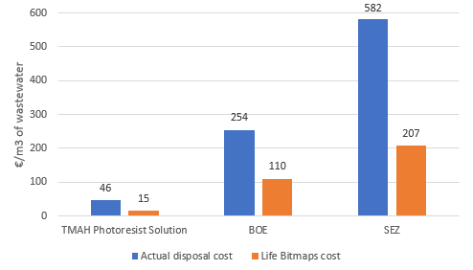
LCC results
Life Bitmaps processes Current wastewater treatment
Vs

Slide 25
LIFE BITMAPS: Conclusions
Main conclusions
Business case: Full scale plant includes
TMAH degradation process → 800 kg/h
BOE treatment –> 2900 kg/b of BOE wastewater per batch and 150 batch/year, annual totaling of 435 ton of BOE
SEZ treatment –> 2900 kg/b of BOE wastewater per batch and 50 batch/year, annual totaling of 145 ton of BOE
2. LCA study shows that the electricity consumption has the highest contribution in most impact categories, as concerns the treatment of TMAH.
3. BOE and SEZ treatment have a quite high impact due to the lime use in precipitation.
4. The whole process improvement, with an impact decrease higher than 50%, is evident, mainly thanks to the TMAH process optimization.
5. Treatment cost for each wastewater has been estimated
33.31 €/m³ of TMAH effluent (actual disposal cost is 45.6 €/m³)
228.35 €/m³ of BOE effluent (actual disposal cost is 253.68 €/m³)
564.70 €/m³ of SEZ effluent (actual disposal cost is 581.8 €/m³)
It is clear that the main advantage is relative to the TMAH treatment, hence it recommends to design the full scale plant to treat all considered wastewaters in order to make the most of the benefits of innovative processes.

Slide 26
Thank You very much for your attention !
BITMAPS website: http://www.lifebitmaps.eu/
This Project receives funding form the European Union Life Programme Under Grant Agreement N. LIFE 15 ENV/IT 000332.

